Slide 1
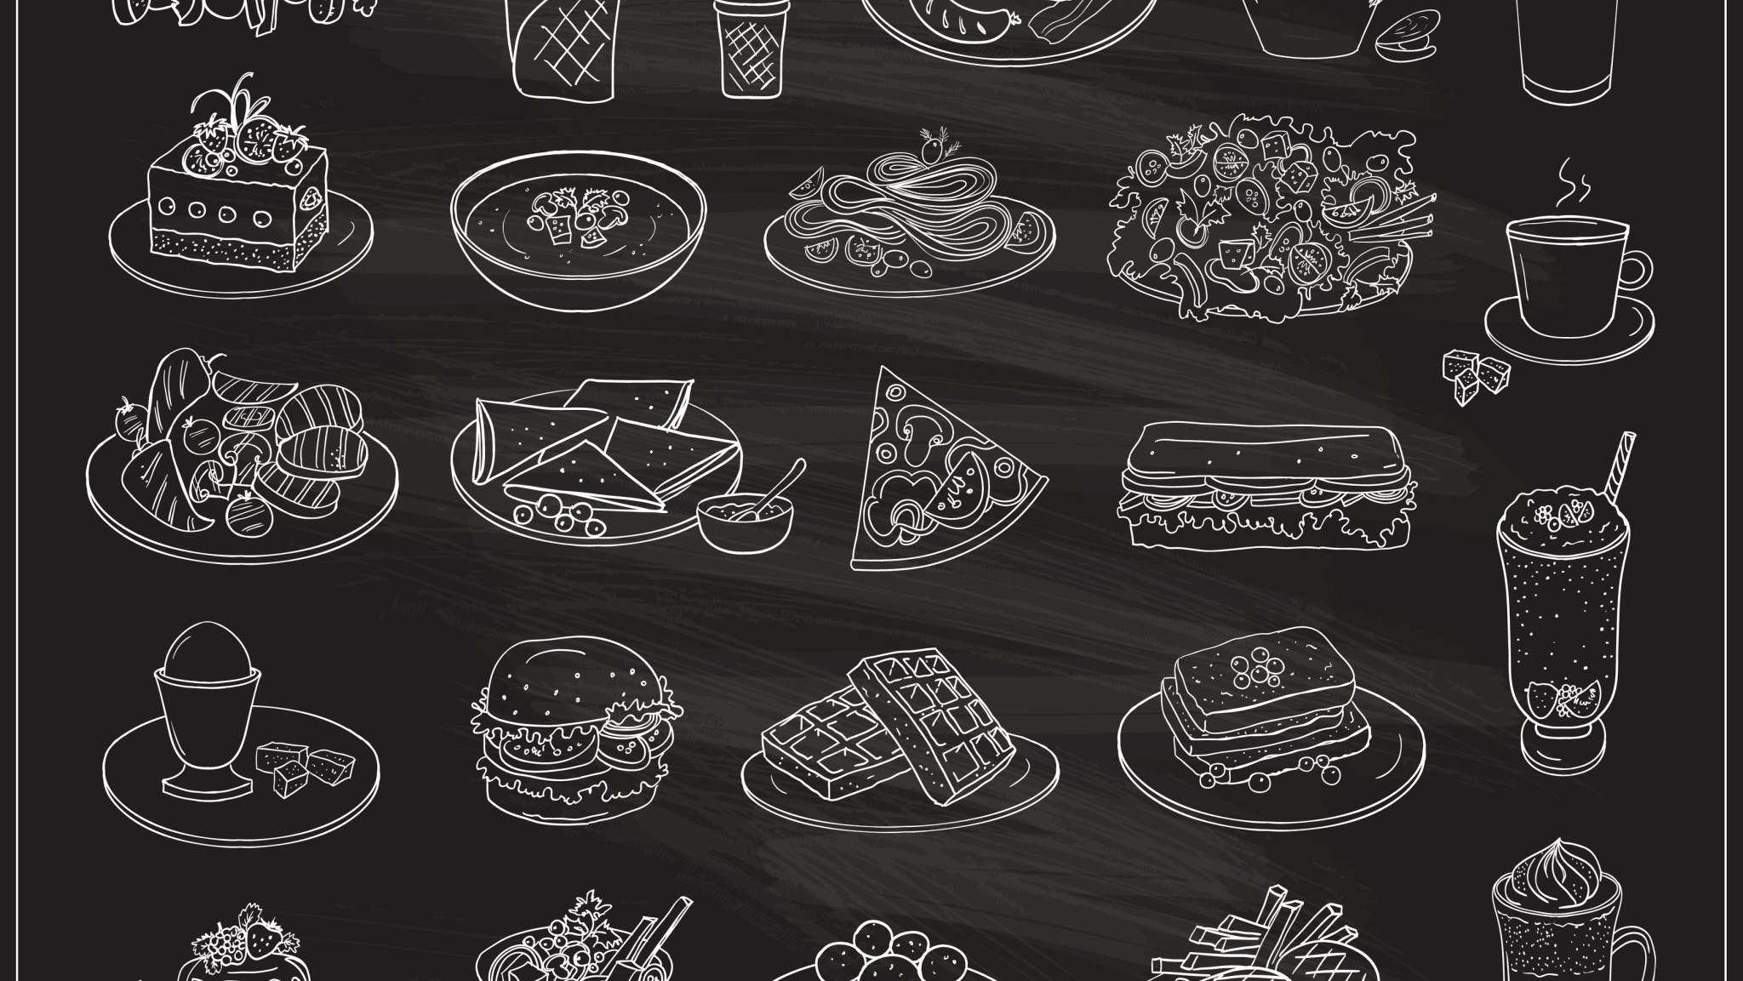
An Image-Based Classifier for Text Extraction from Restaurant Menus
Sandeep Kalari
01215523
Sai Annapragada
01214528

Slide 2
Topics to Discuss
Introduction
Expected output
OCR text extraction
Problems with OCR
DONUT OCR free
How this DONUT works
What we’ve done
Future scope

Slide 3
Introduction
Our goal is to digitization of restaurant menus and classify those text into meaning-full classification.
In this we are using different kinds of OCR that will give text as a output in the image with bounding boxes and OCR-free end-to-end Transformer model.
Get a conclusion which better for the Hotel menu text extraction and classification.

Slide 4
Expected output
We are expecting the output of text and the layout of that text as a bounding boxes
Also, accuracy of each OCR
What are the other alternatives that we can achieve other than OCR for the better accuracy.

Slide 5
OCR text extraction
Optical character recognition or optical character reader is the electronic or mechanical conversion of images of typed, handwritten or printed text into machine-encoded text, whether from a scanned document, a photo of a document, a scene-photo or from subtitle text superimposed on an image.
We have used Different kinds of OCR like easy OCR, keras OCR, etc.

Slide 6
Problems with OCR
Main problem with OCR is the accuracy is Low i.e, while extraction of the text OCR is either missing the text or giving the text in a single colum even though it has multiple colum format
This leads to the Data ambiguity and can’t conclude the accurate results regarding to the text extraction
Current OCR is not suitable for the Hotel menu
We need to develop our own coustomised ocr for the better accuracy which wiil take lot of time and resources.

Slide 7
Donut OCR free
Donut 🍩, Document understanding transformer, is a new method of document understanding that utilizes an OCR-free end-to-end Transformer model.
Donut does not require off-the-shelf OCR engines/APIs, yet it shows state-of-the-art performances on various visual document understanding tasks, such as visual document classification or information extraction

Slide 8
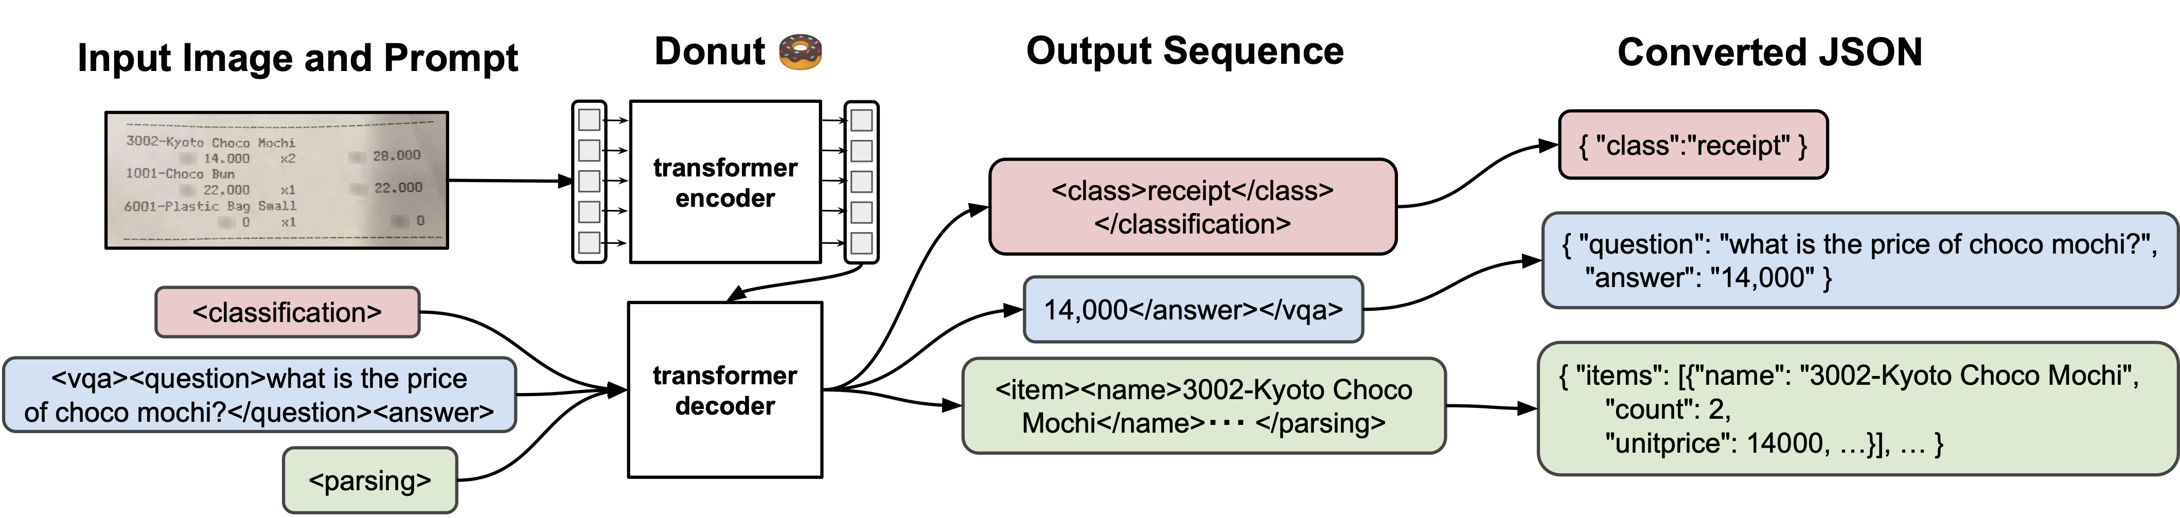
How donut works

Slide 9
We have achived so far
We are able to install all the packages and train the Donut model.
We did a basic demo how donut works on hotel menu.
This will explain how precise it is compared to OCR’s.

Slide 10
Future scope
In future we would like to fine tune the Donut with hotel menu images and extract text from image more accurately By creating Jsonl file and precisely calculate bounding boxes of the image
classify that text according to the text
After the text file creation with Headings and price will be obtained in a json file
According to the Json file we can create a chat bot which will answer the basic questions in menu which is asked by the user.

Slide 11

Thank You

